Slide 1
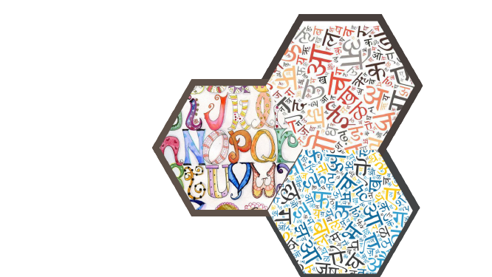
Translatish
NLP Project
(CSC306)
Guided by
Prof. Jaideep Raulji
Prof. Vinay Vachharajani

Slide 2
TEAM MEMBERS
Enrollment No. | Name
AU1841004 | Aanshi Patwari
AU1841052 | Dipika Pawar
AU1841057 | Mayankkumar Tank
AU1841076 | Rahul Chocha
AU1841125 | Yash Patel

Slide 3

INTRODUCTION
As in today’s world, most of the viewers are also less likely to share your content if you haven’t translated and localized your content.
So, in order to get more reach of videos, people have started to work on providing their videos in multiple languages.
Video translation has been a tedious task since
past decades as it includes steps such as transcription,
translation, subtitling, and voice-overs
The translation process applications can help in
making this task simpler and easier.

Slide 4
WHY IS IT REQUIRED?
The main purpose of this to translate spoken audio into viewer’s language
It helps audience to understand and contextualize the video content
Helpful for deaf and hard of hearing people
Helps people remain updated with the latest trends across the globe by providing it in native language.
It can act as a resource for the non-native speaker public who want to use it to practice their vocal skills in their language.

Slide 5
METHODOLOGY
Extract the audio from video
Convert the audio into text using API
Convert the language from English to Hindi
Main focus areas of project are:
Preprocess the data
Train the model
Test the model ( Actual conversion of the input )
Performance measure

Slide 6
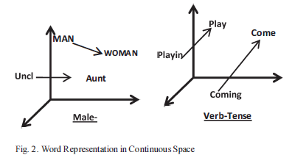
LITERATURE REVIEW
Article 1:- Machine Translation using Deep Learning : An Overview
Use of RNN(Recurrent Neural Network) to reordering for source to target language by the use of semi-supervised learning methods.
Word embedding is used to generate the vector value of the words which can be used for translation purpose.
Use of binary tree structure for mapping the word in the target language with the vector values of the source language.
But RNN has a complex structure which turn in more computations so LSTM is more preferred over RNN.

Slide 7
LITERATURE REVIEW
Article 2:- Neural Machine Translation for English to Hindi
Sequence by sequence learning using LSTM.
Proposed NMT (neural network based machine translation) which has eight layers of encoders and decoders, Core Idea of NMT is to use Deep leading ideas.
Why NMT ? because it requires fraction of a memory compared to conventional models.
Bidirectional RNN as Encoder and Decoder.
Decoder used to predict words in a target sentences.
Encoder-Decoder models are jointly trained to maximize the conditional probabilities of the target sequence given the input sequence.

Slide 8
LITERATURE REVIEW
Comparison of LSTM and RNN
GRU values are also close to LSTM values with lesser run time in comparison to RNN.
The LSTM layer architecture is instead built in such a way the the network “decides” whether to modify its “internal memory” at each step.
Doing so, and if properly trained, the layer can keep track of important events from further in the past, allowing for much richer inference.
LSTM networks were made with one purpose in mind — to solve long term dependency problems that traditional RNNs have.
LSTM networks are specially made to solve long-term dependency problems in RNNs and they are super good at making use of data from a while ago (inherent in its nature) by using cell states and RNN has a complex structure which in turn has more computations therefore making LSTM more preferred over RNN.

Slide 9

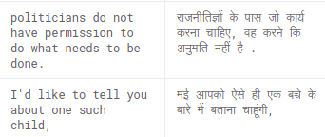
ABOUT PROJECT CORPUS - HindiEnglishCorpora
Bilingual corpora
Part of parallel corpora which contains multiple corporas.
Taken from about 37726 TED talks, news articles, Wikipedia articles.
Has unique 1,24,318 english records and 9,7662 hindi records
Corpus link: HindiEnglishCorpora
Cleaned dataset
It is sentence tokenized (sentence aligned)

Slide 10

TOOLS AND TECHNOLOGY
Python 3.7
Tensorflow
Speech to text API
And etc..

Slide 11
REFERENCES
https://www.researchgate.net/publication/327717152_Neural_Machine_Translation_for_English_to_Hindi
https://ieeexplore.ieee.org/abstract/document/8003957
https://www.kaggle.com/aiswaryaramachandran/hindienglish-corpora
https://medium.com/analytics-vidhya/understanding-encoder-decoder-sequence-to-sequence-architecture-in-deep-learning-ffafe365ef11#:~:text=The%20Encoder%20will%20convert%20the,sequence%20given%20the%20input%20sequence
https://towardsdatascience.com/understanding-bidirectional-rnn-in-pytorch-5bd25a5dd66
https://towardsdatascience.com/a-comparison-of-dnn-cnn-and-lstm-using-tf-keras-2191f8c77bbe
https://medium.datadriveninvestor.com/how-do-lstm-networks-solve-the-problem-of-vanishing-gradients-a6784971a577

Slide 12
Thank you!

